Slide 1
Family name Finder
(Better, more fun name is in search)
This is not a production ready UX research presentation, but a collection of my journey so far. Feedback is very welcome!
I watched all the video material first and read many of the recommended readings. Then I started from the beginning again and decided which exercises I only wanted to do superficially and which in depth.
The following slides contain the summary, of what I think has brought me forward so far.

Slide 2

Problem statement
Couples getting married have to decide on their future surname, which can be an emotional challenging task due to personal values and societal expectations, which is another stressful task they have to deal with before the wedding.

Slide 3

Eligible options
01
Wife and husband can each keep their family name.
02
The wife can take the husband's family name or vice versa.
03
They can adopt a combination of both family names as a common double name.
04
One can keep his surname and the other can adopt a double name.

Slide 4
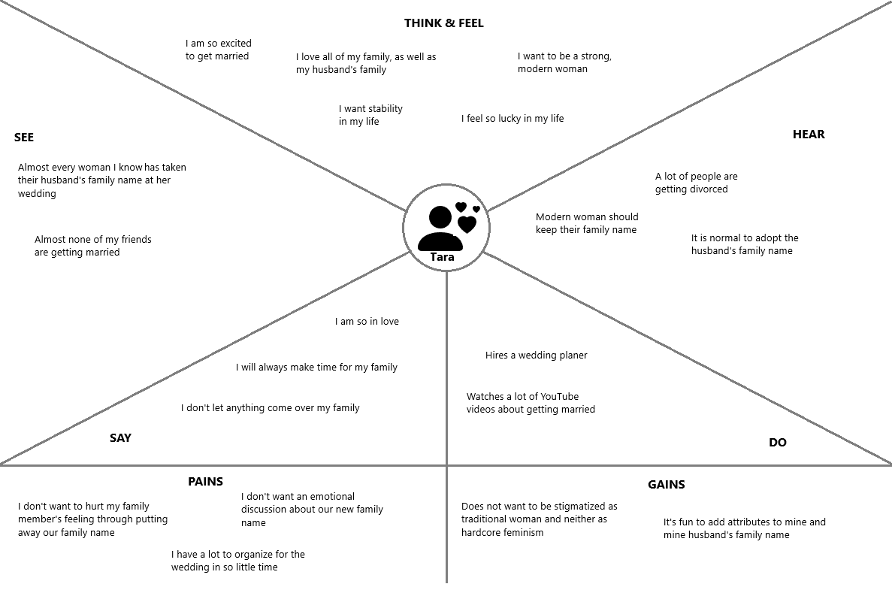
Empathy Map

Slide 5
Survey preparation
Goal
I want to find out, if agreeing to a family name is a relevant problem for couples. What do people associate with their family name? And can AI be of help here?

Slide 6
Survey preparation
Prepared questions (surveymonkey.com seems to be a cool tool)
Scale from one to 10:
- I get often called by my family name.
- I get often called by a nickname based on my family name.
- My family name is important to me.
- To have a common family name with my partner is important to me.
- I associate positive feelings and attributes with my family name.
- I am curious which attributes my friends connect with my family name.
- I would adopt my partner's family name without hesitation.
- I know at least one couple, who had a long discussion about their family name before their wedding.
- I am afraid to upset my family when adopting my partner's family name.
- If I would associate negative attributes with a family name of a friend, I would honestly tell him.
- I enjoy asking AI like ChatGPT questions.
- I trust in answers given by AIs like ChatGPT.
Free comment fields:
- If you have already married: How have you decided your family name?
- Feel any question wasn't on point or something is on your mind?
We are happy to hear about it!

Slide 7
Survey preparation
? Question marks ?
Would the survey really give me new insights?
I already have a concrete app idea in mind, which I want to use for my own wedding. Regardless of the survey feedback, I would probably still follow my app idea for myself.
Building a usable prototype should be doable as a one or two weekend project. Iterating from there feels more practical to me. And it also aligns better with my personal timeline, that the app should be usable soon for myself.
Therefore I decided to skip the survey phase in favor of an earlier, usable and testable prototype.

Slide 8
Product idea
A simple web app consisting of two word clouds for each family name of the wedding couple. Everyone invited can add words to the cloud like “funny”, “serious”, “have their own humor”, etc.
The owner of the web app can have a summary of the word cloud generated, enriched by some generic information, by a large language model like ChatGPT.
The generated output can be used as a basis for a discussion about the future family name. The goal is not exact science, but to provide a nice, entertaining gadget.

Slide 9
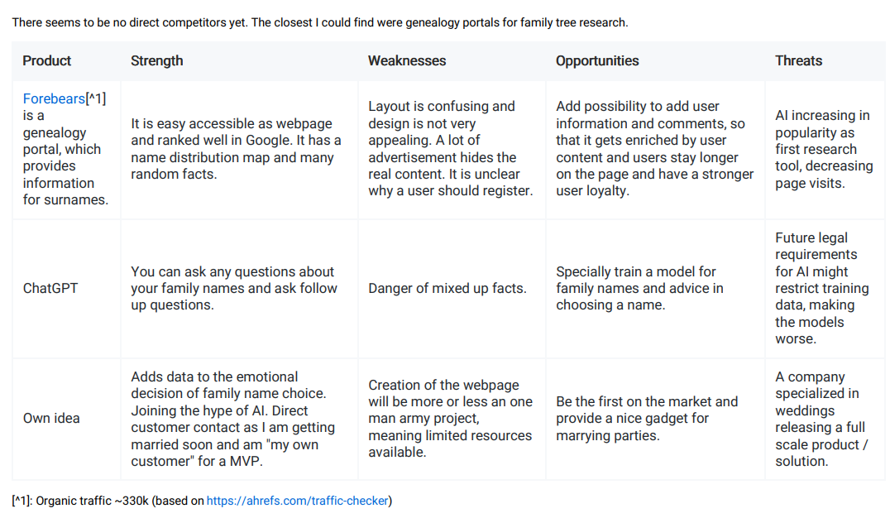
Competitive SWOT Analysis

Slide 10
Minimum Viable Audience
Me and my fiancee
Future
If the web app isn’t nice for our own wedding, just drop the project #FailFast Otherwise go to Phase 2 and 3 #AirbnbStory
Phase 2
Offer friends and family members to use the web app for their wedding. Improve based on their feedback.
Phase 3
Host public web app with some specialized advertisement. E.g. the company where we forged our wedding rings ourselves, or some online jewelry stores might be interested in placing advertisement in the web app and it might also be positively received by the users.

Slide 11
Personas & Journey Map
As I am my own customer and the path to a testable prototype is short and cheap, I decided to not invest in those two artifacts, in favor of an earlier, usable and testable prototype.

Slide 12
Feedback is very welcome!

